Slide 1


Fastag Fraud Detection
Using Machine Learning Model

Slide 2


Introduction
Problem Statement: This project aims to develop an effective fraud detection system for Fastag transactions using machine learning classification techniques. The dataset includes key features such as transaction details, vehicle information, geographical location, and transaction amounts. The goal is to create a robust model that accurately identifies instances of fraudulent activity, ensuring the integrity and security of Fastag transactions. This system will help prevent financial losses and enhance trust in the Fastag system.

Slide 3
Why Is This Project Important?
Enhances Security: The project strengthens the security of Fastag transactions by accurately detecting and preventing fraudulent activities. 2. Reduces Financial Losses: By identifying fraudulent transactions, it minimizes financial losses for users and service providers. 3. Builds Trust: Ensuring transaction integrity boosts user confidence in the Fastag system, promoting wider adoption and usage.

Slide 4
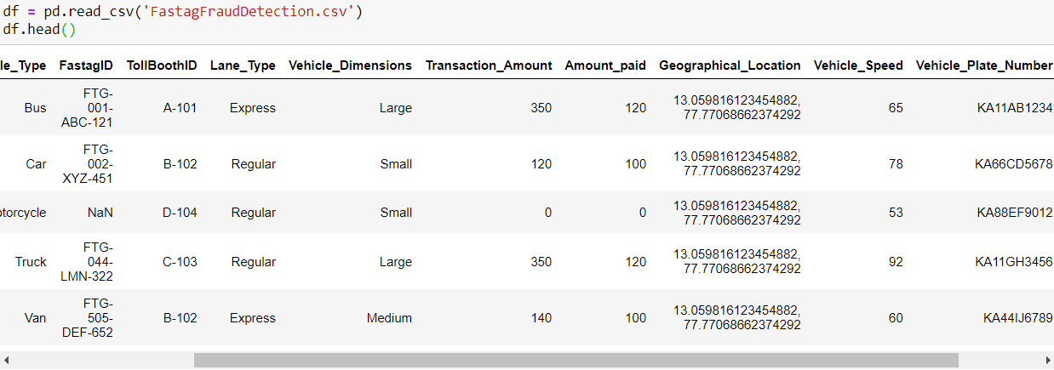
Dataset Overview
1. Transaction_ID: Unique identifier for each transaction.
2. Timestamp: Date and time of the transaction.
3. Vehicle_Type: Type of vehicle involved in the transaction.
4. FastagID: Unique identifier for Fastag.
5. TollBoothID: Identifier for the toll booth.
6. Lane_Type: Type of lane used for the transaction.
7. Vehicle_Dimensions: Dimensions of the vehicle.
8. Transaction_Amount: Amount associated with the transaction.
9. Amount_paid: Amount paid for the transaction.
10. Geographical_Location: Location details of the transaction.
11. Vehicle_Speed: Speed of the vehicle during the transaction.
12. Vehicle_Plate_Number: License plate number of the vehicle.
13. Fraud_indicator: Binary indicator of fraudulent activity (target variable).

Slide 5
Exploratory Data Analysis (EDA)
data.info():
Provides a summary of the dataset, including the number of entries, columns, data types, and non-null counts.
1. Data Understanding and Cleaning: EDA helps to understand the data structure, identify missing values, and detect outliers.
2. Pattern Discovery: It reveals patterns and relationships between variables, such as the impact of experience or job role on salary.
3. Feature Selection and Transformation: EDA aids in selecting relevant features and transforming data to enhance model accuracy and performance.
data.describe():
Generates descriptive statistics for numerical columns, including count, mean, standard deviation, min, and max values.

Slide 6

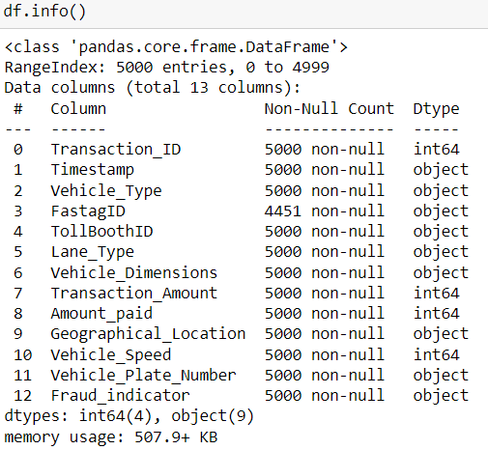
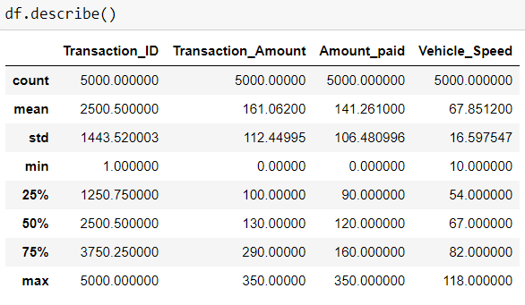
data.info()
data.describe()

Slide 7
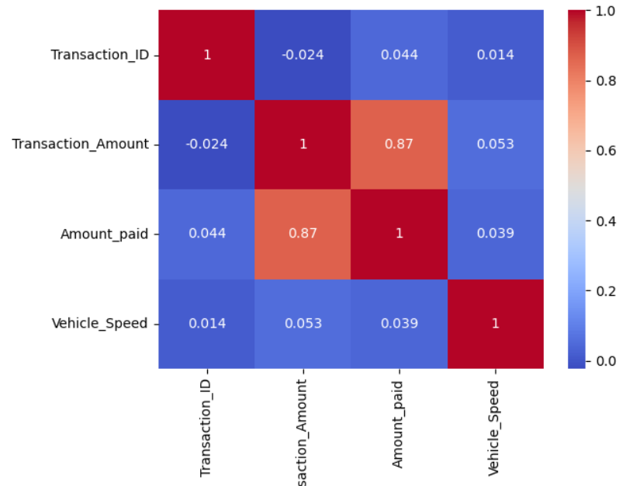
Correlation Heatmap
The correlation heatmap for the variables Transaction_ID, Transaction_Amount, Amount_paid, and Vehicle_Speed reveals that the only significant relationship is between Transaction_Amount and Amount_paid, with a strong positive correlation of 0.87, indicating that higher transaction amounts are closely associated with higher amounts paid. All other pairs, including Transaction_ID with Transaction_Amount (-0.024), Amount_paid (0.044), and Vehicle_Speed (0.014), as well as Transaction_Amount with Vehicle_Speed (0.053) and Amount_paid with Vehicle_Speed (0.039), show very weak or negligible correlations, suggesting no significant linear relationships among them.

Slide 8
Feature Engineering
The code snippet performs feature engineering to create new variables that enhance the predictive power of the model. It generates five new features from existing data. `Amount_diff` calculates the difference between `Transaction_Amount` and `Amount_paid`, capturing any discrepancies which might indicate fraud. `Amount_ratio` provides a proportional measure of the transaction amount to the amount paid, highlighting outliers where the ratio is unusually high or low. `Transaction_time` extracts the time part of the `Timestamp`, which could help identify suspicious activities occurring at odd hours. `Transaction_day` converts the `Timestamp` into the day of the week, as fraudulent transactions might be more frequent on specific days. Finally, `Transaction_hour` derives the hour of the day from the `Timestamp`, helping to detect patterns in the timing of transactions. These engineered features add more dimensions to the data, allowing the model to better identify and predict fraudulent activities by capturing nuances and patterns not evident in the raw data.

Slide 9
Feature Engineering
CODE:
# Create a new feature for the difference between Transaction_Amount and Amount_paid
df['Amount_diff'] = df['Transaction_Amount'] - df['Amount_paid']
# Create a new feature for the ratio between Transaction_Amount and Amount_paid
df['Amount_ratio'] = df['Transaction_Amount'] / df['Amount_paid']
# Create a new feature for the transaction time
df['Transaction_time'] = pd.to_datetime(df['Timestamp']).dt.time
# Create a new feature for the transaction day of the week
df['Transaction_day'] = pd.to_datetime(df['Timestamp']).dt.dayofweek
# Create a new feature for the transaction hour of the day
df['Transaction_hour'] = pd.to_datetime(df['Timestamp']).dt.hour.

Slide 10
The data preprocessing steps start by dropping the unnecessary `Timestamp` column, which is no longer needed after extracting relevant time-based features. The target variable `Fraud_indicator` is separated from the feature set, with `X` containing all predictor variables and `y` containing the target labels. Next, the categorical columns in `X` are identified for encoding. These categorical variables are transformed using `OneHotEncoder`, which converts them into a binary (0 or 1) format, suitable for machine learning models. The `one_hot_encoder` handles any unknown categories by ignoring them. The encoded categorical data is then converted into a DataFrame with appropriate feature names. Finally, the original categorical columns are dropped from `X`, and the encoded features are concatenated with the remaining numerical features, resulting in a fully preprocessed dataset ready for model training. These steps ensure that all features are in a numerical format, enabling the machine learning models to process and learn from the data effectively.
Data Preprocessing

Slide 11
df.drop(['Timestamp'], axis=1, inplace=True)
X = df.drop('Fraud_indicator', axis=1) y = df['Fraud_indicator']
categorical_cols = X.select_dtypes(include=['object']).columns
one_hot_encoder = OneHotEncoder(handle_unknown='ignore') X_encoded = one_hot_encoder.fit_transform(X[categorical_cols])
feature_names = one_hot_encoder.get_feature_names_out(categorical_cols) X_encoded_df = pd.DataFrame(X_encoded.toarray(), columns=feature_names)
X.drop(categorical_cols, axis=1, inplace=True)
Data Preprocessing

Slide 12






Random Forest:
An ensemble model that uses multiple decision trees to improve prediction accuracy and robustness, chosen for its ability to handle complex relationships and non-linear data.
Model Used
WHY?
In this project, Random Forest was chosen due to its high accuracy and ability to handle complex, non-linear relationships within the data. Its ensemble nature makes it robust against overfitting, a common issue in fraud detection where the model might otherwise learn to predict only the existing patterns without generalizing well to new data. Additionally, Random Forest can handle a mix of numerical and categorical features, making it well-suited for the diverse features engineered from the Fastag transaction data. Its interpretability and ability to provide feature importance metrics also help in understanding the key factors driving fraud detection.

Slide 13
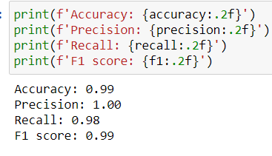
Model Evaluation
Evaluation Metrics :
1. Precision: Precision measures the proportion of true positive predictions among all positive predictions made by the model. It indicates how many of the predicted frauds were actual frauds.
2. Recall: Recall, also known as sensitivity, measures the proportion of true positive predictions among all actual positive instances in the dataset. It shows how many of the actual fraud cases were correctly identified by the model.
3. Accuracy: Accuracy is the ratio of correctly predicted instances (both fraud and non-fraud) to the total number of instances in the dataset. It provides an overall measure of the model’s performance.
4. F1 Score: The F1 score is the harmonic mean of precision and recall, providing a single metric that balances both concerns. It is particularly useful when the dataset is imbalanced, as it considers both false positives and false negatives.
Random Forest Regressor

Slide 14
Conclusion
Potential Improvements and Future Work
To enhance the fraud detection model, further improvements could include the integration of additional features such as vehicle history and user behavior analysis. Incorporating advanced techniques like deep learning and ensemble methods might improve prediction accuracy. Regular model retraining with updated data will ensure the system adapts to new fraud patterns. Moreover, implementing real-time detection and alerts can provide timely intervention. Collaboration with domain experts can also help in refining feature selection and interpretation, ensuring a more robust fraud detection system.

Slide 15
THANK
YOU
BY-
SHREENITA SAHA

